Slide 1
UNIVERSITÀ DEGLI STUDI DI NAPOLI FEDERICO II
WEB TECHNOLOGIES – LECTURE 22
ANGULAR:
TO-DO LIST APP
Luigi Libero Lucio Starace, PhD
luigiliberolucio.starace@unina.it https://luistar.github.io https://www.docenti.unina.it/luigiliberolucio.starace

Slide 2
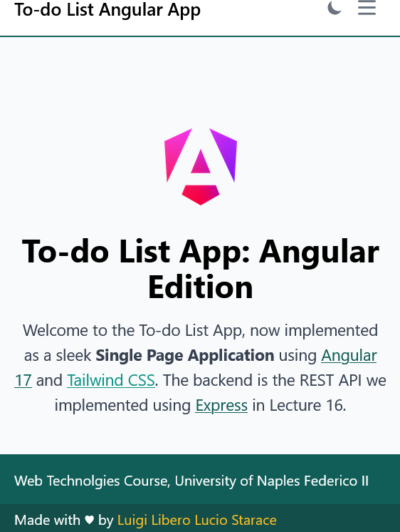
TO-DO LIST WEB APP: SPA EDITION
Today, we’ll implement the good ol’ To-do List App as a modern SPA
We will use the REST backend developed back in Lecture 15
And add a nice Angular 17 frontend on top of it
REST API
Express
HTTP

Slide 3
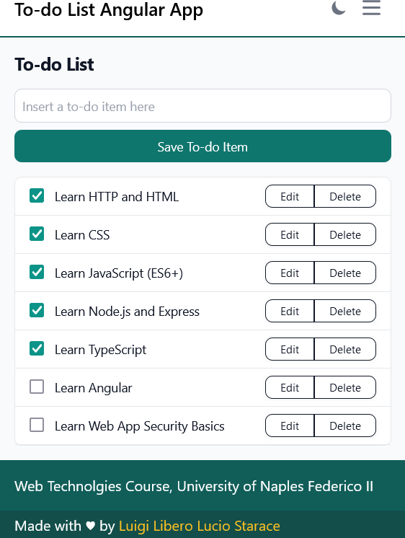
TO-DO LIST WEB APP: SPA EDITION
During today’s lecture, we’ll check out the Angular To-do List SPA the teacher implemented
The source code is available in the course materials on Teams
In the remainder of these slides, we’ll go over some of the interesting parts for reference

Slide 4

TO-DO LIST SPA: LIVE DEMO TIME

Slide 5
TO-DO LIST SPA: ROUTES
/* Nothing much is going on here */
export const routes: Routes = [{
path: "home", component: HomepageComponent, title: "To-do List Angular App"
}, {
path: "login", component: LoginComponent, title: "Login | To-do List Angular App"
}, { /*some routes were omitted for the sake of brevity*/ path: "todos", component: TodoPageComponent,
title: "To-do List | To-do List Angular App",
canActivate: [authGuard]
}, {
path: "todos/:id", component: TodoDetailComponent, title: "To-do Detail | To-do List Angular App", canActivate: [authGuard]
}
];
Notice that two routes are guarded by authGuard
Notice that this route
is parametric!

Slide 6
TO-DO LIST SPA: AUTHGUARD
export const authGuard: CanActivateFn = (route, state) => { const authService = inject(AuthService);
const toastr = inject(ToastrService); const router = inject(Router); if(authService.isUserAuthenticated()){
return true;
} else {
toastr.warning("Please, login to access this feature", "Unauthorized!"); return router.parseUrl("/login"); //return a UrlTree
}
};

Slide 7
TO-DO LIST SPA: LOGIN COMPONENT
export class LoginComponent { toastr = inject(ToastrService); router = inject(Router);
restService = inject(RestBackendService); authService = inject(AuthService);
submitted = false;
Biagio Morgillo
2024-06-04 09:13:55
--------------------------------------------
Mostra all'utente che deve inserire mail e password
loginForm = new FormGroup({
user: new FormControl('', [Validators.required]), pass: new FormControl('', [
Validators.required, Validators.minLength(4), Validators.maxLength(16)])
});
handleLogin() {/* handles login submit */}
}
Biagio Morgillo
2024-06-04 09:15:47
--------------------------------------------
Validator è una classe presa da AngularForm

Slide 8
TO-DO LIST SPA: LOGIN COMPONENT
handleLogin() { this.submitted = true; if(this.loginForm.invalid){
this.toastr.error("Invalid data!", "Oops! Invalid data!");
} else { this.restService.login({
usr: this.loginForm.value.user as string, pwd: this.loginForm.value.pass as string,
}).subscribe({
next: (token) => { this.authService.updateToken(token as string); },
Biagio Morgillo
2024-06-04 09:23:10
--------------------------------------------
Il primo è il titolo, il secondo è il body
error: (err) complete: ()
=> { this.toastr.error("Invalid", "Oops! Invalid credentials");},
=> {
this.toastr.success(`Welcome`,`Welcome ${this.loginForm.value.user}!`);
this.router.navigateByUrl("/todos");
}
})
}
}

Slide 9
TO-DO LIST SPA: LOGIN TEMPLATE
Interesting bit from the LoginComponent template
We conditionally show input errors only when needed
We use the new Angular 17 control flow syntax @if!
<label for="pass" class="classes-omitted">Password</label>
<input type="password" formControlName="pass" id="pass" class="omitted" required=""> @if(submitted && loginForm.controls.pass.errors){
@if(loginForm.controls.pass.errors['required']){
<p class="form-error">Password is required.</p>
}
@if(loginForm.controls.pass.errors['minlength']){
<p class="form-error">Password should contain at least 4 characters</p>
}
}

Slide 10
TO-DO LIST SPA: AUTH SERVICE
type AuthState = { user: string | null, token: string | null,
isAuthenticated: boolean
}
@Injectable({ providedIn: 'root'
})
export class AuthService {
authState: WritableSignal<AuthState> = signal<AuthState>({ user: this.getUser(),
token: this.getToken(), //get token from localStorage, if there
isAuthenticated: this.verifyToken(this.getToken()) //verify it's not expired
})
10

Slide 11
TO-DO LIST SPA: AUTH SERVICE
@Injectable({
providedIn: 'root'
})
export class AuthService {
//continues from the previous slide
user = computed(() => this.authState().user); token = computed(() => this.authState().token);
isAuthenticated = computed(() => this.authState().isAuthenticated);

Slide 12
TO-DO LIST SPA: AUTH SERVICE
@Injectable({ providedIn: 'root'}) export class AuthService {
//continues from the previous slide constructor(){
effect( () => { //we use an effect to keep data aligned with localStorage
const token = this.authState().token; const user = this.authState().user; if(token !== null)
localStorage.setItem("token", token);
else
localStorage.removeItem("token"); if(user !== null)
localStorage.setItem("user", user);
else
localStorage.removeItem("user");
});
}

Slide 13
TO-DO LIST SPA: REST BACKEND SERVICE
@Injectable( { providedIn: 'root' } )
export class RestBackendService { url = "http://localhost:3000"
constructor(private http: HttpClient) {}
httpOptions = {
headers: new HttpHeaders({
'Content-Type': 'application/json'
})
};
login(loginRequest: AuthRequest){ const url = `${this.url}/auth`;
return this.http.post<string>(url, loginRequest, this.httpOptions);
}
//rest of the service omitted for the sake of brevity
}
export | interface | AuthRequest | {
usr: | string,
pwd: } | string
13

Slide 14
TO-DO LIST SPA: AUTH INTERCEPTOR
function authInterceptor(request: HttpRequest, next: HttpHandlerFn) { const authService = inject(AuthService);
const token = authService.getToken();
if (token) {
// Clone the request and add the Authorization header with the token request = request.clone({
setHeaders: {
Authorization: 'Bearer ' + token
}
});
}
return next(request); // Continue with subsequent interceptors, if any
}

Slide 15
TO-DO LIST SPA: TO-DO PAGE COMPONENT
export class TodoPageComponent { createTodoSubmitted = false;
restService = inject(RestBackendService); toastr = inject(ToastrService);
router = inject(Router);
todos: TodoItem[] = []; //array of TodoItems
newTodoForm = new FormGroup({
todo: new FormControl('', [Validators.required])
});
ngOnInit() { this.fetchTodos(); } fetchTodos(){ /*...*/ } handleTodoSubmit(){ /*...*/ }
handleDelete(id: number | undefined){ /*...*/ }
}

Slide 16
TO-DO LIST SPA: TO-DO TEMPLATE
Interesting bit shown below
Note that <app-todo-item> is a separate component, taking care of displaying a single To-do Item in the list
The TodoItem to show is passed as a property
Note that the component can also emit delete events
<ul class="classes-omitted">
@for(item of todos; track item.id){
<app-todo-item [todoItem]=item (delete)="handleDelete($event)"/>
} @empty {
<li class="classes-omitted">No to-do items to show.</li>
}
</ul>

Slide 17
THE TO-DO ITEM COMPONENT
export class TodoItemComponent {
@Input({ required: true}) todoItem: TodoItem;
@Output() delete: EventEmitter<number | undefined> = new EventEmitter(); editLink = "";
restBackend = inject(RestBackendService);
toastr = inject(ToastrService);
ngOnInit(){ this.editLink = "/todos/"+this.todoItem?.id; } handleToggleDoneStatus(){ /*...*/ }
handleDelete(){ /*...*/ }
}

